Slide 1
Layered Structure of Operating System
The operating system can be implemented with the help of various structures.
The structure of the OS depends mainly on how the various common components of the operating system are interconnected and melded into the kernel.
The layered structure approach breaks up the operating system into different layers and retains much more control on the system.
The bottom layer (layer 0) is the hardware, and the topmost layer (layer N) is the user interface. These layers are so designed that each layer uses the functions of the lower-level layers only.
It simplifies the debugging process.

Slide 2
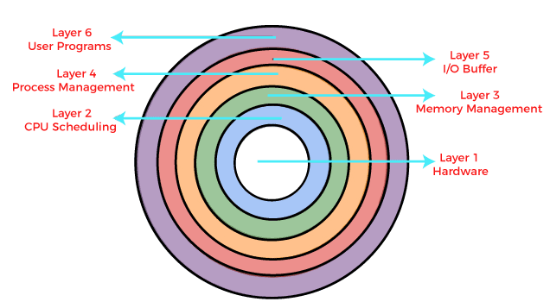

Slide 3
Hardware: This layer interacts with the system hardware and coordinates with all the peripheral devices used, such as a printer, mouse, keyboard, scanner, etc. The hardware layer is the lowest and most authoritative layer in the layered operating system architecture.
CPU Scheduling: This layer deals with scheduling the processes for the CPU. Many scheduling queues are used to handle processes.
Memory Management: Memory management deals with memory and moving processes from disk to primary memory for execution and back again.

Slide 4
Process Management: This layer is responsible for managing the processes, i.e., assigning the processor to a process and deciding how many processes will stay in the waiting schedule. The priority of the processes is also managed in this layer.
I/O Buffer: This layer handles the buffers for the I/O devices and makes sure that they work correctly. Suppose you are typing from the keyboard. There is a keyboard buffer attached with the keyboard, which stores data for a temporary time.
User Programs: This is the highest layer in the layered operating system. This layer deals with the many user programs and applications that run in an operating system, such as word processors, games, browsers, etc.

